Slide 1
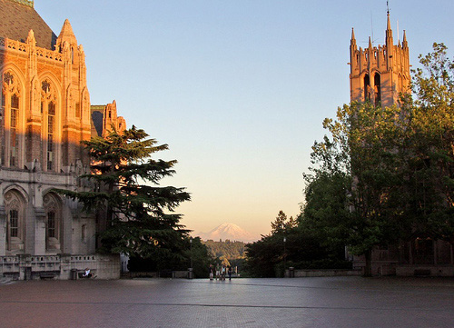

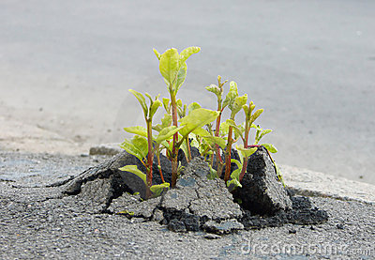
Data Science Incubator

Slide 2





A 5-year, $37.8 million cross-institutional collaboration

Slide 3
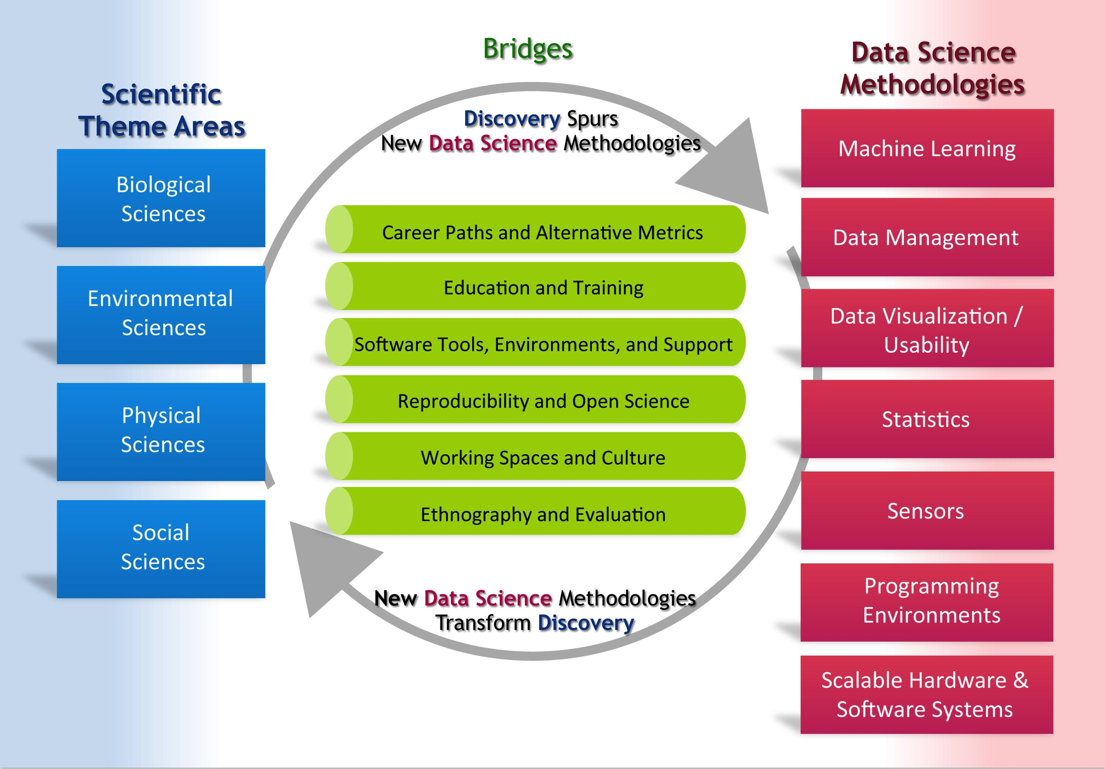
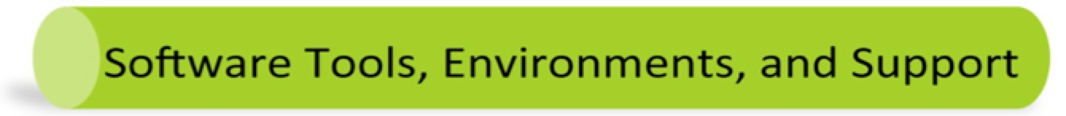
Establish a virtuous cycle
6 working groups, each with
3-6 faculty from each institution

Slide 4
Incubator Program Overview
Goal: Create watercooler opportunities and scale our efforts by co-locating collaborations from different fields in the studio
Protocol: ~1-page proposals for 1-quarter, on-site data science collaborations with us
What we look for: Projects where fruitful collaboration is possible, with potential for significant impact, and that have sustained engagement
http://data.uw.edu/incubator
Notes:
We find that short-term, intensive projects have high payoff but are difficult to support with extenral funding or by asking a student to work on it half-time.
If we can turn a 6-month project into a 6-week project, that’s of interest to us.
If we can identify collaborations that lead to new science and new methodologies, that’s even better.
Particpants sit with us and lead the project – the idea is to interact with each other as much as us

Slide 5
Fall Incubator Pilot Program Logistics
Applications in August/September 2014
Each proposal identifies a Project Lead (PL)
The person doing the work, not the thesis advisor
Incubator participants join the studio 2 days/week
Pilot program operated out of Sieg 326
Weekly group standups, blog posts, heavy use of GitHub
http://uwdatascienceincubator.wordpress.com/
http://github.com/uwescience/incubator
Notes:
Motivation for milestones: “dashboard” for our sponsors, commitment to “open notebook science”
Our goals:
Support high-impact science
Refine this program so that it can be applied by our partners
Attract new funding to support this program

Slide 6
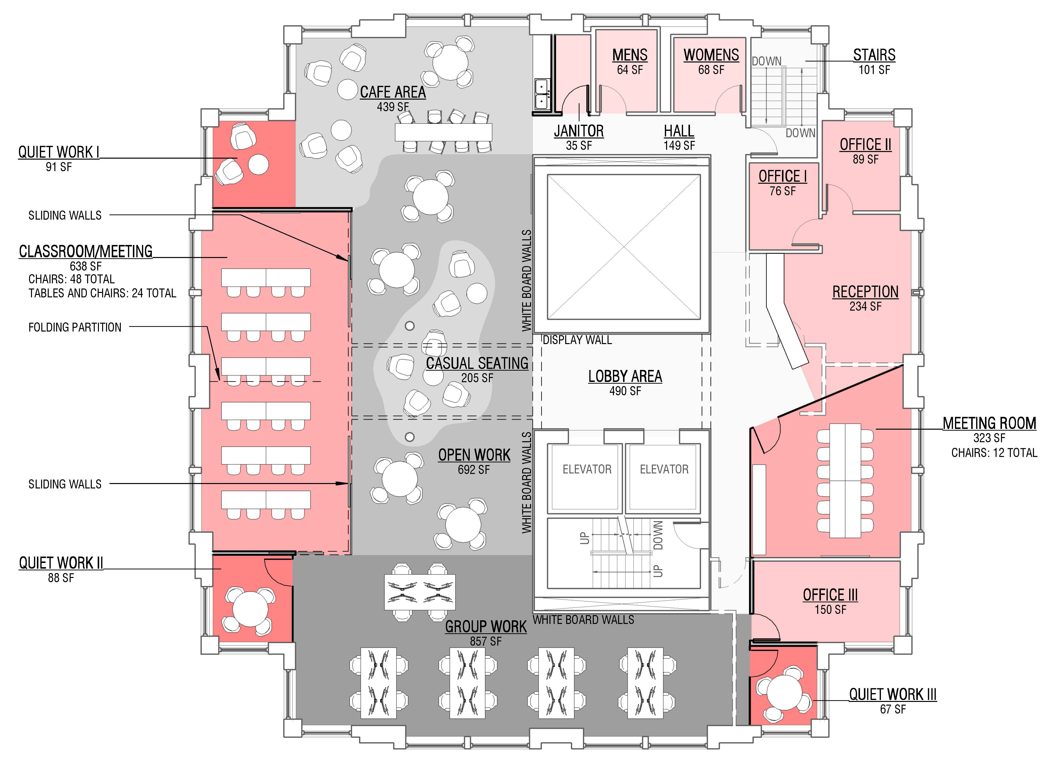
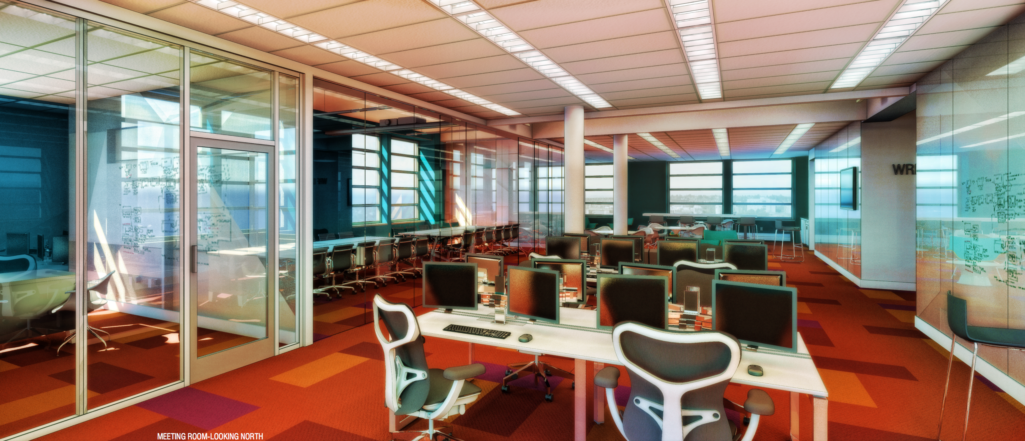
WRF Data Science Studio
Funded by a $10M grant from the Washington Research Foundation

Slide 7
This is an experiment!
Our goals
Help advance new directions in data-intensive science
Reinforce and expand the eScience collaboration network
Gather requirements for new tools and infrasructure
Collect and publish success stories
A strategy
Increase casual technical interaction – optimize for attention span
Improve access to mutual expertise
Focus on short time scales and “small bets”
Borrow ideas from commercial software development

Slide 8
Introductions
Kernel-Based Moving Object Detection
Andrew Becker (Astronomy), Daniel Halperin (eScience)
Students' sleep and academic performance
Ângela Katsuyama (Biology), Bill Howe (eScience), Daniel Halperin (eScience)
Simulating Competition in the U.S. Airline Industry
Carlos A. Manzanares (Economics), Andrew Whitaker (eScience)
Analysis of .gov web archive data
Emily Gade (Political science), Andrew Whitaker (eScience)
Innovation: Evidence from Patents
Matthew Denes (Finance and Business Economics), Andrew Whitaker (eScience)
Analysis of large-scale patterns in phytoplankton diversity
Sophie Clayton (Oceanography), Daniel Halperin (eScience)

